Slide 1


NLP : Recurrent Neural Network
Video 3: Types of RNN

Slide 2
Types of RNN
Many to One
Many to Many
Many to Many
One to Many
One to One
Output at each time step
Hidden Layers
Vectorized Input

Slide 3
Types of RNN
Many to One
Many to Many
Many to Many
One to Many
One to One
Output at each time step
Hidden Layers
Vectorized Input

Slide 4

1. Many to One
Expects sequential data in input and non sequential data in output.
Output
For example:
Input as sentence, time series etc
Pixel Games

Slide 5
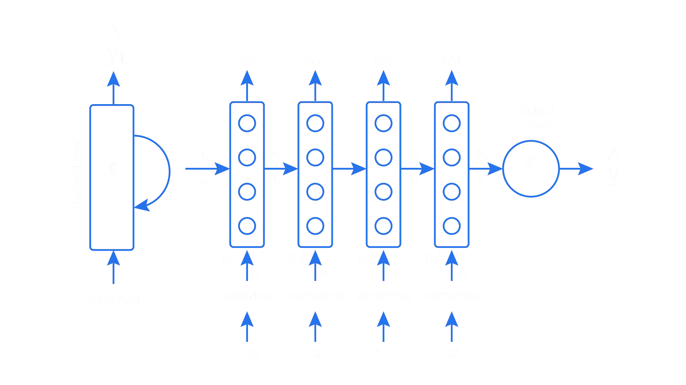

1. Many to One
Interim time step outputs are not used
w_{h}
w_{h}
w_{h}
w_{h}
w_{y}
x
x
x
x
This game is bad

Slide 6
Types of RNN
Many to One
Many to Many
Many to Many
One to Many
One to One
Output at each time step
Hidden Layers
Vectorized Input

Slide 7
Types of Many-to many RNN
Many to Many
1
Input sequence = Output sequence
Many to Many
2
Input sequence = Output sequence

Slide 8
1
Input sequence = Output sequence
Outputs
For example: Part-of-Speech Tagging
Inputs

Slide 9
Input sequence = Output sequence
1
PRON
VERB
VERB
NOUN
Outputs
Inputs
They
enjoy
playing
football

Slide 10
2
Input sequence = Output sequence
Output
For example: Machine Translation
Input

Slide 11
2
Input sequence = Output sequence
Wie
geht
es
dir
Output
Input
How are
you

Slide 12
Types of RNN
Many to One
Many to Many
Many to Many
One to Many
One to One
Output at each time step
Hidden Layers
Vectorized Input

Slide 13

3. One to Many
Expects non sequential data in input and sequential data in output.
Output in
non-sequence
For example:
Input as single
non-sequential data
Image Captioning

Slide 14

3. One to Many
Expects non sequential data in input and sequential data in output.
Output : sequence of notes or chords
For example:
Input : single musical note or chord
Music Generation

Slide 15
Types of RNN
Many to One
Many to Many
Many to Many
One to Many
One to One
Output at each time step
Hidden Layers
Vectorized Input

Slide 16
4. One to One
Expects non sequential data in both input and output.
Output
Input

Slide 17
Thank you

